Slide 1
Introduction to Computer Graphics
Course Title: Computer Graphics
Course Code: CSE - 413

Slide 2
Content of this Lecture | Resources will be followed:
Introduction Of Computer Graphics Picture vs Photo vs Image Application Of Computer Graphics Graphics Software Graphics Monitor Pixel Vs Point Mega-pixels Calculations Exercise Of Pixels Aspect Ratio Aspect Ratio Solved Problems Pixel Density Pixel Density Solved Problems Aspect Ratio & Pixel Density Solved Problems | Reference Book(s): 1. Computer Graphics Principle and Practice -- James D Foley, Van Dam 2. Computer Graphics Using Open GL – F S Hill J R 3. OpenGL programming Guide-( Official guide to learning opengl ) Reference websites to follow:- https://www.javatpoint.com/computer-graphics-tutorial https://www.geeksforgeeks.org/computer-graphics-2/ https://www.tutorialspoint.com/computer_graphics/index.htm https://www.gatevidyalay.com/computer-graphics/ Recommended YouTube playlists:- https://www.youtube.com/playlist?list=PLMW5djzR9cKMs2_R1c59401IVQOMOs0pr https://www.youtube.com/playlist?list=PLncy2sD7w4YpWn8jM9Sk6ISOsCZ7oLn9r https://www.youtube.com/playlist?list=PLrjkTql3jnm9cY0ijEyr2fPdwnH-0t8EY https://www.youtube.com/playlist?list=PLYwpaL_SFmcAtxMe7ahYC4ZYjQHun_b-T

Slide 3
Introduction of Computer Graphics
Graphics are defined as any sketch or a drawing or a special network that pictorially represents some meaningful information. Computer Graphics is used where a set of images needs to be manipulated or the creation of the image in the form of pixels and is drawn on the computer.
To plot some points on a computer screen to make an image
Computer graphics involves technology to accept, process, transform and present information in a visual form that also concerns with producing images using a computer
The study of creating, manipulating, and using visual images in the computer
An art of drawing pictures, lines, charts etc. on computer screen by using programming is known as computer graphics. The activities involved in computer graphics are computations, creation and manipulation of data. The images are generated and manipulated by a rendering tool known as computer graphics.
In computer graphics objects are presented as a collection of discrete pixel elements.

Slide 4
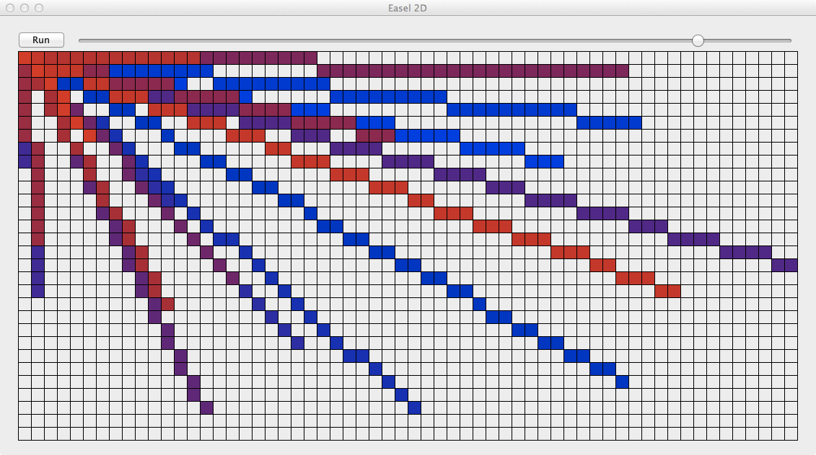
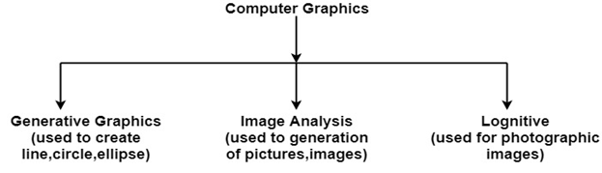
Computer Graphics refers to several things:
The manipulation and the representation of the image or the data in a graphical manner.
Various technology is required for the creation and manipulation.
Digital synthesis and its manipulation.
What is a Picture?
Picture — A drawing, painting, or artwork created on a computer.
What is a Photo?
Photo or photograph — Anything taken by a camera, digital camera, or photocopier.
What is an Image?
Image — Any visual object modified or altered by a computer or an imaginary object created using a computer. A picture that is store in some electronic form. Eg any picture file in your computer.

Slide 5
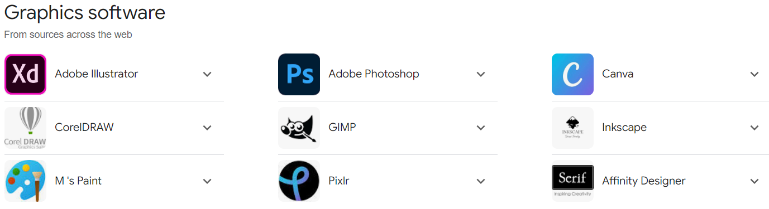
Application of Computer Graphics
Computer graphics user interfaces GUIs: A graphic, mouse-oriented paradigm which allows the user to interact with a computer.
Business presentation graphics − "A picture is worth a thousand words".
Cartography − Drawing maps.
Weather Maps − Real-time mapping, symbolic representations.
Satellite Imaging − Geodesic images.
Photo Enhancement − Sharpening blurred photos.
Medical imaging − MRIs, CAT scans, etc. - Non-invasive internal examination.
Engineering drawings − mechanical, electrical, civil, etc. - Replacing the blueprints of the past.
Educational Software: Computer Graphics is used in the development of educational software for making computer-aided instruction.
Entertainment − Movies and games.
Printing Technology: Computer Graphics is used for printing technology and textile design.
Visualization: It is used for visualization of scientists, engineers, medical personnel, business analysts for the study of a large amount of information.
Typography − The use of character images in publishing - replacing the hard type of the past.
Architecture − Construction plans, exterior sketches - replacing the blueprints and hand drawings of the past.
Art − Computers provide a new medium for artists.
Training − Flight simulators, computer aided instruction, etc.
Simulation and modeling − Replacing physical modeling and enactments

Slide 6
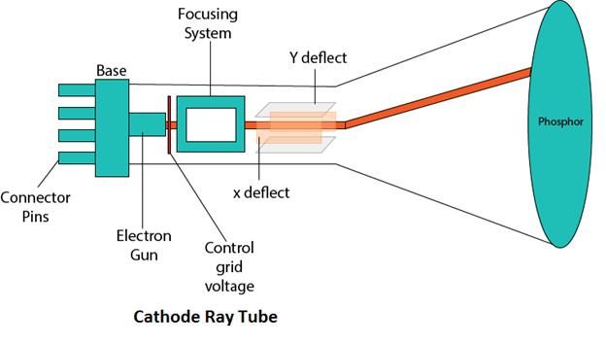
Graphics Monitor: Cathode ray tube(CRT) or refresh CRT
Definition:- Cathode ray tube(CRT) is vacuum tube containing an electron gun and a fluorescent screen to accelerate and deflect the electron beam, used to create images in the form of light emitted from florescent screen.
The image may represent electrical waveforms(oscilloscope), pictures(tv, monitor), radar targets and others.
Components of CRT/ operations of CRT:-
Electron gun
Control grid
Heating filament
Focusing system
accelerating anodes
Deflection system
Phosphor coated screen

Slide 7
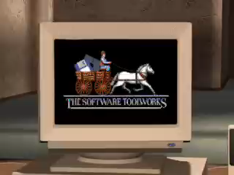
How CRT works

Slide 8
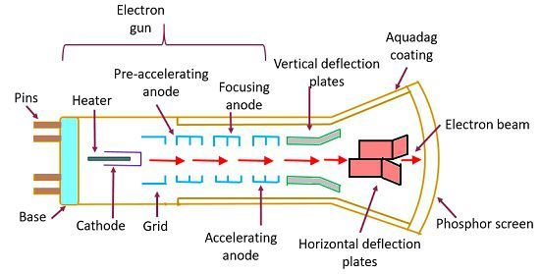
Internal Structure of CRT graphics monitor

Slide 9
Operations Of CRT:-
1. Electron gun:
it consist of control grid & heating filament which emits beams of electron(cathode rays). the electron beam passes through focusing and deflection system that direct it towards specified positions on the phosphor-coated screen. when the beam hits the screen, the phosphor emits a small spot of light at each position contacted by the electron beam. the light emitted by the phosphor fades very rapidly therefore to keep the picture it is necessary to keep the picture glowing. This is achieved through redrawing the picture repeatedly by quickly directing the electron beam back over the same points & display using this technique is called refresh CRT.
2. Control grid: controls the flow of electrons(e-) emitted by the electron gun.
3. Heating filament: heat is supplied to the cathode by directing current through filament. heat causes the electrons(e-) to be boiled off the hot cathode surface.
4. Focusing node: it is used to create a clear picture by focusing the electrons into a narrow beam. the responsibility of focusing system is to converge electron beam to a small spot where it strikes the phosphor. otherwise, the e- will repeat each other and beam would disperse.
5. Accelerating anode: negatively charged electron are then accelerated towards the phosphor coating by a high-definition positive voltage.
6. Deflecting system: it consist of horizontal & vertical deflection plate. it controls the directions of electron beam by using electric or magnetic field.
7. Phosphor-coated screen: it glows when the high-energy electron beam strikes the screen.

Slide 10
Properties of CRT:
1. Persistence: It is defined as the time it takes the emitted light from the phosphor to decay to one-tenth(1/10-th) of it's original intensity. It means how long they continue to emit light after the e-beam is removed.
Persistence range from 1- to 60 micro-seconds.
In short, Persistence is the duration of phosphorescence exhibited b y a phosphor.
2. Refreshing of the screen: It is done by keeping the phosphorous glowing to redraw the picture repeatedly. By quickly directing the electron beam back to the same points.
3. Refresh rate: It is the number of time per second the image is redrawn on the screen.
4. Critical Fusion Frequency(CFF): It is the refresh rate at which the image stops flickering and fuses into a steady image.
5. Horizontal Scan Rate(HSN): It is the number of line that can be scanned per second by the CRT.
HSN = Refresh Rate * No. of scan line
6. Pixel: Smallest unit of a digital image that can be displayed and represented on a digital display device.
If a monitor has a property of 200ppi(pixel per inch), then there are 200pixel of per square inch.
7. Pixel Resolution: It is the number of points per inch that can be plotted horizontally and vertically.
If an image has M rows and N columns, then it's resolution can be defined as M X N

Slide 11
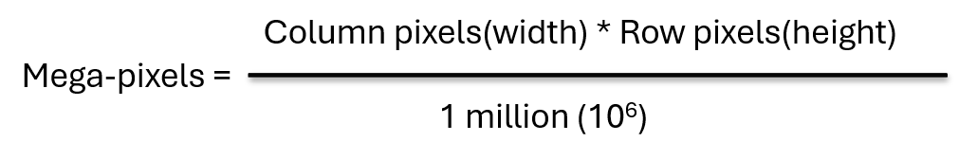
Pixel vs Point
Mega-pixels Calculations:
Pixel: A pixel is a point sample 'picture element', a single dot in your image.
A 10x10 image is made-up of a set of pixels = 100 pixels
Point: The point on the other hand is a unit of length 1pt is equally to exactly 1/72th of an inch.
if your image is 72ppi,
then 1 pt = 1 pixel
shades or Bit's Per Pixel: 2^{bpp}
The famous gray scale image is of 8 bpp , means it has 256 different colors in it or 256 shades.
Example-2: Image dimension = 2500 x 3192. What is the pixel resolution in megapixels?
Solution:
So, Pixel resolution = 2500 x 3192
= 7980000bytes
= 7980000 / 1000000
= 7.98 = 8 mega pixel(approximately)
Example-1: Assume a picture has 1024 rows and 1024 columns.
What is the size of an image?[Assume there are 8-bits per pixel]
Solution:
Size of an image = row x col x bpp
= 1024 x 1024 x 8
= 8388608 bits
= 8388608/8 = 1048576 bytes
= 1048576/1024 = 1024Kb
= 1024/1024
= 1Mb
BPP or Bits per Pixel is used to denote the number of bits per pixel and the number depends on the depth of color or BPP.
Ex: Let row be 3000 and columns be 1687, and it has 256 shades of bpp. Size of an image = rows * cols * bpp =3000 * 1687 * 8 = 40488000 bits
As it is not a standard answer so we can convert it in the following ways:
Converting it into bytes = 8388608 / 8 = 5061000 bytes. Converting into kilo bytes = 5061000 / 1024 = 4942kb. Converting into Mega bytes = 4942 / 1024 = 4 Mb.

Slide 12
Exercise of Pixel Problems:
1. What do you mean by resolution 800 x 600?
Solution: The resolution 800 x 600 refers to the number of pixels along the width (800 pixels) and height (600 pixels) of an image or display screen.
This means there are a total of 800×600=480,000 pixels in the image or display.
2. How many pixels for a 3 x 2-inch image at a resolution of 300 pixels per inch?
Solution: To find the total number of pixels, multiply the dimensions in inches by the resolution in pixels per inch (PPI):
Width in pixels=3×300=900 pixels
Height in pixels=2×300=600 pixels
Total pixels=900×600=540,000 pixels
3. Compute the size of a 640 x 480 image at 96 pixels per inch or how can measure a 640 x 480 image at 96 pixels per inch?
Solution: To find the size in inches, divide the pixel dimensions by the pixels per inch (PPI):
Width in inches = 640 / 96 ​≈ 6.67 inches
Height in inches = 480 / 96 ​≈ 5 inches
So, the size of the image is approximately 6.67 x 5 inches.
4. Compute the pixels per inch of a 2 x 2 inch image that has 512 x 512 pixels.
Solution: To find the PPI, divide the pixel dimensions by the size in inches:
Pixels per inch=512/2​=256 PPI
5. Compute the pixels per inch of a 3 x 2 inch image that has 900 x 600 pixels.
Solution: For the width and height, calculate the PPI separately (they should be the same if the image has uniform resolution):
Width PPI= 900 / 3 ​= 300 PPI
Height PPI= 600 / 2 ​=300 PPI
So, the pixels per inch (PPI) of the image is 300 PPI.

Slide 13
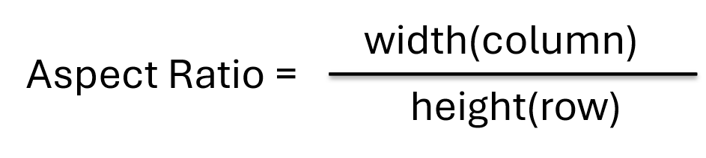
Aspect ratio:
Ratio of width to height of device.
It is the ratio of vertical points to horizontal point's necessary to produce equal-length lines in both direction on the screen.
An aspect ratio is a proportional relationship between on images width and height.
it is commonly explained as two numbers separated by a colon(:)
Advantage of Aspect Ratio:
1. Maintain a balance between the appearances of an image on the screen.
2. Maintain a ration between horizontal and vertical pixel
3. It does not let the image to get distorted
4. When the aspect ratio is increased that is the quality remains the same

Slide 14
What do you mean by aspect ratio 1:1?
it means that for every 1 units of width(column)
there are 1 units of height(row)
And, the height & width are same.
So, the image could be:
500px * 500px
1500px * 1500px
300px * 300px
This ration is commonly used in printing photographs, mobile screens, social media platforms.
What do you mean by aspect ratio 2:3?
it means that for every 2 units of width(column)
there are 3 units of height(row)
And, the image is 1.5(3/2)times higher than it is width
So, the image could be:
500px * 750px
1500px * 2250px
What do you mean by aspect ratio 4:3?
For Every 4 unit of width(column)
there are 3 unit of height(row)
And, the image is 1.33(4/3)times wider than it is high
So, the image could be:
400px * 300px
600px * 450px
1000px * 750px
This ration is commonly used in TV, PC monitor, Digital Camera
Q. What do you mean by aspect ratio 3:2?
Q. What do you mean by aspect ratio 16:9?

Slide 15
Aspect Ratio Solved Problems
Q1. If you are given an image with an aspect ratio of 6:2 and a pixel resolution of 480,000 pixels, given that the image is grayscale.
You are asked to calculate the dimensions of the image:
1. Resolve the pixel resolution to calculate the dimensions of the image.
2. Calculate the size of the image.
Part-1: Given Information: - Aspect ratio = 6:2 (which can be simplified to 3:1) - Total pixel resolution = 480,000 pixels - The image is grayscale (1 byte per pixel) Step 1: Resolve Pixel Resolution to Calculate Dimensions of the Image Since the aspect ratio is 3:1, let’s denote: - Width = 3x - Height = x The area in terms of pixels is: Width × Height = 480,000 3x × x = 480,000 3x² = 480,000 x² = 480,000 / 3 = 160,000 x = √160,000 = 400 Now, substitute x to find the dimensions: - Height = x = 400 - Width = 3x = 1200 So, the dimensions of the image are 1200 x 400 pixels.
Part-2: Calculate the Size of the Image Since it’s a grayscale image (1 byte per pixel), the image size is calculated as: Size = Total Pixels × Bytes per Pixel Size = 480,000 × 1 = 480,000 bytes Converting this to kilobytes: Size = 480,000 / 1024 ≈ 468.75 KB Final Answer: - Dimensions: 1200 x 400 pixels - Size: Approximately 468.75 KB

Slide 16
Q2. An image has an aspect ratio of 5:4 and a pixel resolution of 800,000 pixels. The image is in grayscale.
1. Calculate the width and height (dimensions) of the image in pixels.
2. Determine the size of the image in kilobytes (KB), assuming 1 byte per pixel.
Part-1: Calculate Dimensions of the Image
Given Information:
- Aspect ratio = 5:4
- Total pixel resolution = 800,000 pixels
- The image is grayscale (which usually means 1 byte per pixel)
Since the aspect ratio is 5:4, we denote:
- Width = 5x
- Height = 4x
The area in terms of pixels is:
Width × Height = 800,000
5x × 4x = 800,000
20x² = 800,000
x² = 800,000 / 20 = 40,000
x = √40,000 = 200
Now, substitute x to find the dimensions:
- Width = 5x = 5 × 200 = 1000 pixels
- Height = 4x = 4 × 200 = 800 pixels
So, the dimensions of the image are 1000 x 800 pixels.
Part-2: Calculate the Size of the Image
Since it’s a grayscale image (1 byte per pixel), the image size is calculated as:
Size = Total Pixels × Bytes per Pixel
Size = 800,000 × 1 = 800,000 bytes
Converting this to kilobytes:
Size = 800,000 / 1024 ≈ 781.25 KB
Final Answer:
- Dimensions: 1000 x 800 pixels
- Size: Approximately 781.25 KB
Question 3:
You are given a grayscale image with a pixel resolution of 1,200,000 pixels and an aspect ratio of 7:3.
a. Calculate the dimensions (width and height) of the image in pixels.
b. If each pixel takes 1 byte, calculate the size of the image in kilobytes (KB).
Question 4:
A grayscale image has a pixel resolution of 1,000,000 pixels with an aspect ratio of 4:1.
a. Find the width and height (dimensions) of the image in pixels.
b. Calculate the size of the image in kilobytes (KB), assuming 1 byte per pixel.

Slide 17
Example 5:
The aspect ratio for a television screen is the ratio of the width to the height of the screen. For a high-definition TV, it is 16 to 9. What is the height of a screen that is 48 inches wide?
Solution:
Given width = 48 inches and aspect ratio = 16:9
Height = (Width × Aspect Ratio Height) / Aspect Ratio Width
Height = (48 × 9) / 16 = 27.00 inches
Example 6:
If an image has a width of 4 inches and an aspect ratio of 3:2, then what is its height?
Solution:
Given width = 4 inches and aspect ratio = 3:2
Height = (Width × Aspect Ratio Height) / Aspect Ratio Width
Height = (4 × 2) / 3 = 2.67 inches
Example-7:
If an image a height of 2 inches and an aspect ratio of 1.5, what is its width?
Solution:
Calculating the width of an image with a height of 2 inches and an aspect ratio of 1.5:
The aspect ratio is given as 1.5, so
Width=Aspect Ratio × Height=1.5×2=3 inches
Example-8:
If we want to resize a 1024 x 768 image to one that is 640-pixels wide with the same aspect ratio, what would be the height of the resized image?
Solution:
Resizing a 1024 x 768 image to a width of 640 pixels while maintaining the aspect ratio:
The aspect ratio is the ratio of width to height, which we calculate as:
Aspect Ratio=Width / Height​=1024 ​/ 768=1.3333
To maintain this aspect ratio with a width of 640 pixels, calculate the new height
New Height=New Width / Aspect Ratio​=640 / 1.3333​≈480 pixels

Slide 18
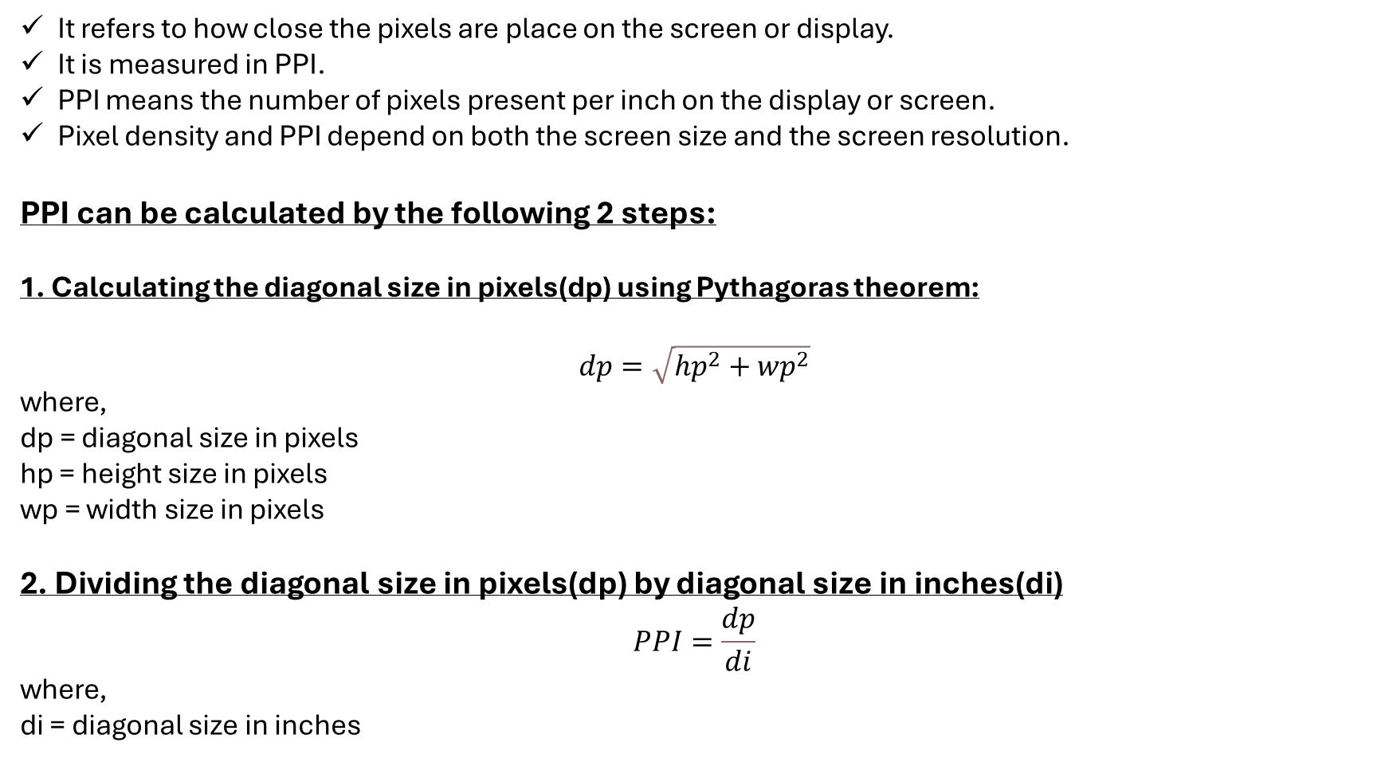
Pixel Density:
It refers to how close the pixels are place on the screen or display.
It is measured in PPI.
PPI means the number of pixels present per inch on the display or screen.
Pixel density and PPI depend on both the screen size and the screen resolution.
PPI can be calculated by the following 2 steps:
1. Calculating the diagonal size in pixels(dp) using Pythagoras theorem:
$$dp=\sqrt{{hp}^{2}+{wp}^{2}}$$
where,
dp = diagonal size in pixels
hp = height size in pixels
wp = width size in pixels
2. Dividing the diagonal size in pixels(dp) by diagonal size in inches(di)
$$PPI=\frac{dp}{di}$$
where,
di = diagonal size in inches

Slide 19
Pixel Density Solved Problems
Example 1: For a 5.5 inch screen with 1920 x 1080 pixels resolution, what will be the pixel per inch?
Solution:
1. Screen size: 5.5 inches
2. Resolution: 1920 x 1080 pixels
Step 1: Calculate the diagonal resolution in pixels:
Diagonal pixels = √(1920^2 + 1080^2) = √(3686400 + 1166400) ≈ 2202.91
Step 2: Calculate PPI:
PPI = 2202.91 / 5.5 ≈ 400.53
Answer: Approximately 400.53 PPI
Example 2: For a 5 inch screen with 1920 x 1080 pixels resolution, what will be the pixel per inch?
Solution:
1. Screen size: 5 inches
2. Resolution: 1920 x 1080 pixels
Step 1: Calculate the diagonal resolution in pixels:
Diagonal pixels = √(1920^2 + 1080^2) ≈ 2202.91
Step 2: Calculate PPI:
PPI = 2202.91 / 5 ≈ 440.58
Answer: Approximately 440.58 PPI
Example 3: For a 50 inch screen with 1920 x 1080 pixels resolution, what will be the pixel per inch?
Solution:
1. Screen size: 50 inches
2. Resolution: 1920 x 1080 pixels
Step 1: Calculate the diagonal resolution in pixels:
Diagonal pixels = √(1920^2 + 1080^2) ≈ 2202.91
Step 2: Calculate PPI:
PPI = 2202.91 / 50 ≈ 44.06
Answer: Approximately 44.06 PPI
Example 4: For a 40 inch screen with 1920 x 1080 pixels resolution, what will be the pixel per inch?
Solution:
1. Screen size: 40 inches
2. Resolution: 1920 x 1080 pixels
Step 1: Calculate the diagonal resolution in pixels:
Diagonal pixels = √(1920^2 + 1080^2) ≈ 2202.91
Step 2: Calculate PPI:
PPI = 2202.91 / 40 ≈ 55.07
Answer: Approximately 55.07 PPI

Slide 20
Aspect Ratio & Pixel Density Solved Problems
Example-1:
Given that a 22 inch monitor with an aspect ratio of 16:9 has a monitor resolution of 1920 x 1080, what is the width of the monitor?
Solution:
1. Screen size: 22 inches (diagonal)
2. Aspect ratio: 16:9
Using the Pythagorean theorem with the aspect ratio,
Let, width = 16x
height = 9x.
The diagonal in terms of x is:
√((16x)² + (9x)²) = 22
√(256x² + 81x²) = 22
√337x² = 22
x = 22 / √337 ≈ 1.198
Calculate the width:
Width = 16x ≈ 16 * 1.198
≈ 19.17 inches
Answer: Width ≈ 19.17 inches
Example-2:
Find the width and height of a 40 inch full HD(1920 X 1080) TV screen.
Solution:
1. Screen size: 40 inches (diagonal)
2. Aspect ratio: 16:9
Using the same method,
Let, width = 16x
height = 9x.
The diagonal in terms of x is:
√((16x)² + (9x)²) = 40
√(256x² + 81x²) = 40
√337x² = 40
x = 40 / √337 = 2.178
Calculate the width and height:
Width = 16x ≈ 16 * 2.178
≈ 34.863 inches
Height = 9x ≈ 9 *2.178
≈ 19.61 inches
Answer: Width ≈ 34.863 inches,
Height ≈ 19.61 inches
Example-3:
Find the width and heigth of an older 20 inch TV whose screen has an aspect ratio of 4:3.
Solution:
1. Screen size: 20 inches (diagonal)
2. Aspect ratio: 4:3
Let, width = 4x
height = 3x.
The diagonal in terms of x is:
√((4x)² + (3x)²) = 20
√(16x² + 9x²) = 20
√25x² = 20
x = 20 / √25 = 20 / 5 = 4
Calculate the width and height:
Width = 4x = 4 * 4 = 16 inches
Height = 3x = 3 * 4 = 12 inches
Answer: Width = 16 inches,
Height = 12 inches

Slide 21
Example-4:
Find the width of height of a newer 60 inch TV whose screen has an aspect ratio of 16:9.
Solution:
1. Screen size: 60 inches (diagonal)
2. Aspect ratio: 16:9
Let, width = 16x
height = 9x.
The diagonal in terms of x is:
√((16x)² + (9x)²) = 60
√(256x² + 81x²) = 60
√337x² = 60
x = 60 / √337 ≈ 3.268
Calculate the width and height:
Width = 16x ≈ 16 * 3.268
≈ 52.3 inches
Height = 9x ≈ 9 * 3.2681
≈ 29.4 inches
Answer: Width ≈ 52.3 inches,
Height ≈ 29.4 inches
Example-5:
A wide screen TV has an aspect ratio of 16:9. Find the width of a diagonal on a wide-screen TV that has a height of 25.2.
Solution:
1. Height = 25.2 inches
2. Aspect ratio: 16:9
Since height = 9x and we know height is 25.2:
9x = 25.2
x = 25.2 / 9 ≈ 2.8
Calculate the width :
Width = 16x ≈ 16 * 2.8 ≈ 44.8 inches
The diagonal in terms of x is:
Diagonal = √(Width² + Height²)
≈ √(44.8² + 25.2²)
≈ √(2007.04 + 635.04)
≈ √2642.08 ≈ 51.4 inches
Answer:
Width ≈ 44.8 inches,
Diagonal ≈ 51.4 inches

